Slide 1
Navigating Secondary Trauma, Difficult Cases, and Other Challenges in SFR Committees
NOVEMBER 12, 2024
COLUMBUS, OHIO
Susan Herzfeld
Epidemiologist
Public Health – Dayton & Montgomery County
OHIO SUICIDE FATALITY REVIEW BEST PRACTICES SUMMIT

Slide 2
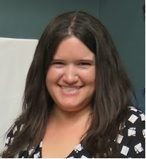
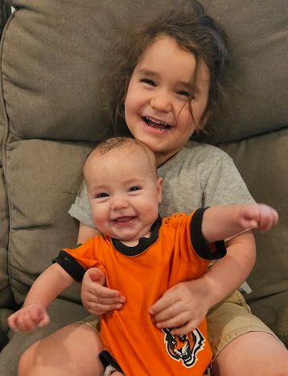
About Me
Fatality review since 2015.
Epidemiologist in Montgomery County since 2017.
Behavioral Health.
Surveillance, Data Reporting, Fatality Review
Community Partnerships.
Mom
Theater fan
Former Roller Derby Skater
NOVEMBER 12, 2024
COLUMBUS, OHIO
OHIO SUICIDE FATALITY REVIEW BEST PRACTICES SUMMIT

Slide 3
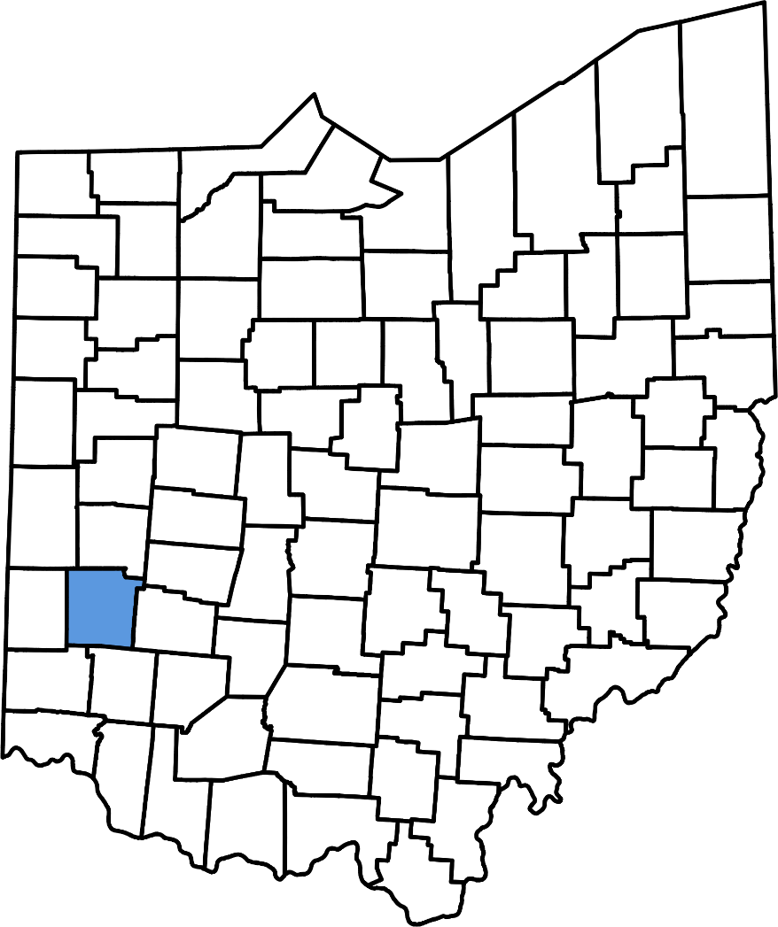
Montgomery County
Includes Dayton, 537,000 residents.
High rate of Overdose, 2017 peak.
OFR began in 2019
Increasing number of suicides.
SFR began in 2021
NOK Interviews
NOVEMBER 12, 2024
COLUMBUS, OHIO
OHIO SUICIDE FATALITY REVIEW BEST PRACTICES SUMMIT

Slide 4
Challenges in Fatality Review
Secondary Trauma
Care for Committee Members
Self-Care
Reviewing Difficult Cases
Limited Information
No Clear Approach to Prevention
Community Engagement
Member Participation
Suicide Prevention Stakeholder Involvement
Next of Kin Interview Recruitment
NOVEMBER 12, 2024
COLUMBUS, OHIO
OHIO SUICIDE FATALITY REVIEW BEST PRACTICES SUMMIT

Slide 5
Secondary Trauma and Self-Care
Secondary Trauma
Care for Committee Members
Care for Self
NOVEMBER 12, 2024
COLUMBUS, OHIO
OHIO SUICIDE FATALITY REVIEW BEST PRACTICES SUMMIT

Slide 6
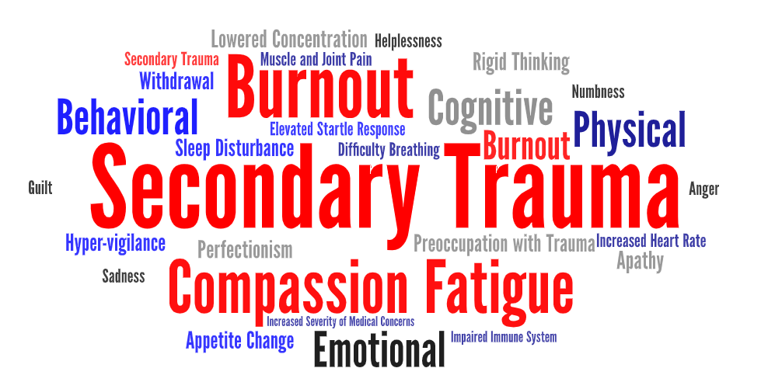
Secondary Trauma
Challenge: Witnessing or discussing details of a suicide death can be traumatic for committee members.
What is secondary Trauma?
Special consideration for Suicide exposure
How does it impact SFR?
Emergency Response
Fatality Review
How can I help?
Name the problem
Discuss self care
Debrief
NOVEMBER 12, 2024
COLUMBUS, OHIO
OHIO SUICIDE FATALITY REVIEW BEST PRACTICES SUMMIT
Notes:
https://www.acf.hhs.gov/trauma-toolkit/secondary-traumatic-stress

Slide 7
Care for Committee Members
Meeting format
Combined/Standalone
Length and Frequency
Case Selection
Coping mechanisms
Humor
Detached
Debrief
Solicit feedback about process
Check-in with members
NOVEMBER 12, 2024
COLUMBUS, OHIO
OHIO SUICIDE FATALITY REVIEW BEST PRACTICES SUMMIT
Notes:
Meeting format- standalone committee or meeting (Suicide only) allows members to opt out of sensitive conversations. IE a peer supporter who has information about overdose deaths may not wish to hear details about a suicide death. Consider meeting length and frequency, number and types of cases discussed, preparation time, etc as factors that can influence amount of trauma experienced.
-Montgomery County meets for 90 minutes quarterly. Members often have traumatic jobs, and many are members of other fatality reviews.
Allow space for feedback regarding meeting structure and content and make required changes to meetings. In Montgomery County, I hold back on the call for anyone who wants to chat; a clinical member of the team often joins me in case someone is experiencing distress.
Some first responders may have coping mechanisms that others view as dark or insensitive. It is important to recognize these as protective and discuss their use/impact with the team. Others may speak about deaths in a clinical or detached manner.

Slide 8
Self Care
Physical Health
Diet, exercise, sleep
Boundaries
Time and Place
Content of discussions
Talk
Coworker, friend, therapist
Make a plan
ID strategies
Set a time
Solutions focus
Postvention
Connect
Fatality Reviews
Prevention
Behavioral Health
Take care of you!
Your Strategy
NOVEMBER 12, 2024
COLUMBUS, OHIO
OHIO SUICIDE FATALITY REVIEW BEST PRACTICES SUMMIT

Slide 9
Self Care
Self Care Strategies
Physical
Psychological
Emotional
Spiritual
Workplace/Professional
What are your strengths?
Where would you like to improve?
NOVEMBER 12, 2024
COLUMBUS, OHIO
OHIO SUICIDE FATALITY REVIEW BEST PRACTICES SUMMIT
Notes:
https://ncwwi.org/files/Incentives__Work_Conditions/What_About_You_Workbook.pdf

Slide 10
Self Care
Physical Self-Care
Eat regularly (e.g., breakfast and lunch)
Eat healthfully
Exercise
Lift weights
Practice martial arts
Get regular medical care for prevention
Get medical care when needed
Take time off when you're sick
Get massages or other body work
Do physical activity that is fun for you
Take time to be sexual
Get enough sleep
Wear clothes you like
Take vacations
Take day trips, or mini-vacations
Get away from stressful technology
NOVEMBER 12, 2024
COLUMBUS, OHIO
OHIO SUICIDE FATALITY REVIEW BEST PRACTICES SUMMIT
Notes:
https://ncwwi.org/files/Incentives__Work_Conditions/What_About_You_Workbook.pdf

Slide 11
Self Care
Psychological Self-Care
Make time for self-reflection
Go to see a psychotherapist or counselor
Write in a journal
Read literature unrelated to work
Do something at which you are a beginner
Take a step to decrease stress in your life
Notice your inner experience-your dreams, thoughts, imagery, feelings
Let others know different aspects of you
Engage your intelligence in a new area-go to an art museum, performance, sports event, exhibit, or other cultural event
Practice receiving from others
Be curious
Say no to extra responsibilities sometimes
Spend time outdoors
NOVEMBER 12, 2024
COLUMBUS, OHIO
OHIO SUICIDE FATALITY REVIEW BEST PRACTICES SUMMIT
Notes:
https://ncwwi.org/files/Incentives__Work_Conditions/What_About_You_Workbook.pdf

Slide 12
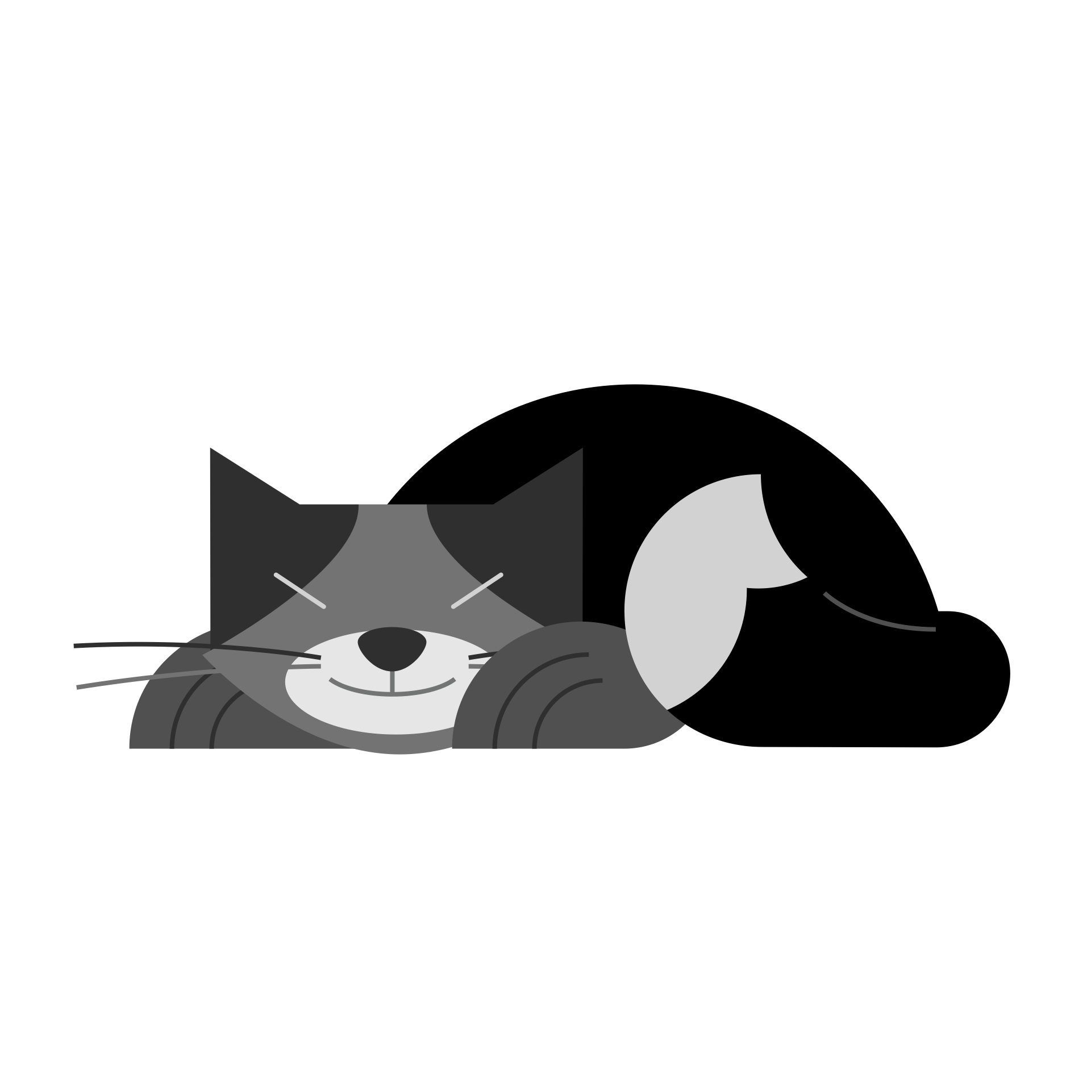
Self Care
Emotional Self-Care
Spend time with others whose company you enjoy
Stay in contact with important people in your life
Treat yourself kindly (supportive inner dialogue or self-talk)
Identify and seek out comforting activities, objects, people, relationships, places yourself
Find things that make you laugh
Express your outrage in a constructive way
Play with children
NOVEMBER 12, 2024
COLUMBUS, OHIO
OHIO SUICIDE FATALITY REVIEW BEST PRACTICES SUMMIT
Notes:
https://ncwwi.org/files/Incentives__Work_Conditions/What_About_You_Workbook.pdf

Slide 13
Self Care
Spiritual Self Care
Make time for prayer, meditation, reflection
Spend time in nature
Participate in a spiritual gathering, community or group
Be open to inspiration
Cherish your optimism and hope
Be aware of nontangible (nonmaterial) aspects of life
Be open to mystery, to not knowing
Identify what is meaningful to you and notice its place in your life
Sing
Express gratitude
Celebrate milestones with rituals that are
Remember and memorialize loved ones who have died
Nurture others
Have awe-full experiences
Contribute to or participate in causes you believe
Read inspirational literature
Listen to inspiring music
NOVEMBER 12, 2024
COLUMBUS, OHIO
OHIO SUICIDE FATALITY REVIEW BEST PRACTICES SUMMIT
Notes:
https://ncwwi.org/files/Incentives__Work_Conditions/What_About_You_Workbook.pdf

Slide 14
Self Care
Workplace/Professional Self Care
Take time to eat lunch
Take time to chat with co-workers
Make time to complete tasks
Identity projects or tasks that are exciting, growth-promoting, and rewarding for you
Set limits with clients and colleagues
Balance your caseload so no one day is "too much!"
Arrange your workspace so it is comfortable and comforting
Get regular supervision or consultation meaningful
Have a peer support group
NOVEMBER 12, 2024
COLUMBUS, OHIO
OHIO SUICIDE FATALITY REVIEW BEST PRACTICES SUMMIT
Notes:
https://ncwwi.org/files/Incentives__Work_Conditions/What_About_You_Workbook.pdf

Slide 15
Self Care
2 minutes
Breathe Stretch Daydream Take your stress temperature Laugh Doodle Acknowledge one of your accomplishments Say no to a new responsibility Complement yourself Look out the window Spend time with your pet Share a favorite joke
5 minutes
Listen to music Have a cleansing cry Chat with a co-worker Sing out loud Jot down dreams Step outside for fresh air Enjoy a snack or make a cup of coffee/tea
What are your strengths?
Where would you like to improve?
NOVEMBER 12, 2024
COLUMBUS, OHIO
OHIO SUICIDE FATALITY REVIEW BEST PRACTICES SUMMIT
Notes:
https://ncwwi.org/files/Incentives__Work_Conditions/What_About_You_Workbook.pdf

Slide 16
Self Care
10 minutes
Evaluate your day Write in a journal Call a friend Meditate Tidy your work area Assess your self care Draw a picture Dance Listen to soothing sounds Surf the web Read a magazine
30 minutes
Get a massage Exercise Eat lunch with a co-worker Take a bubble bath Read non-work related literature Spend time in nature Go shopping Practice yoga Watch your favorite television show
NOVEMBER 12, 2024
COLUMBUS, OHIO
OHIO SUICIDE FATALITY REVIEW BEST PRACTICES SUMMIT
Notes:
https://ncwwi.org/files/Incentives__Work_Conditions/What_About_You_Workbook.pdf

Slide 17
Reviewing Difficult Cases
Cases with Limited Information
Cases with No Clear Prevention Approach
NOVEMBER 12, 2024
COLUMBUS, OHIO
OHIO SUICIDE FATALITY REVIEW BEST PRACTICES SUMMIT

Slide 18
Reviewing Difficult Cases
Challenge: Committees have little information for some reviewed cases.
Causes of Limited Information
Few contacts with local agencies
Little information from Coroner’s Office
No Next of Kin Information
Guide Discussion
What questions do we have?
Where can we get answers?
Develop Process Recommendations
Identify new members
Seek new data
Develop interview questions
NOVEMBER 12, 2024
COLUMBUS, OHIO
OHIO SUICIDE FATALITY REVIEW BEST PRACTICES SUMMIT

Slide 19
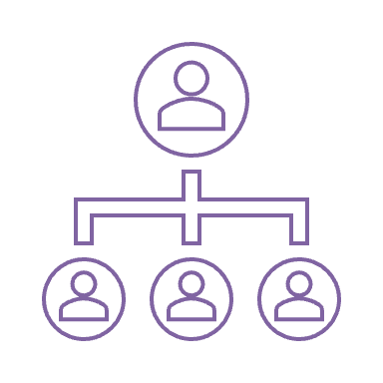
Reviewing Difficult Cases
Challenge: Committees have difficulty envisioning recommendations to prevent a death.
Cases with No Clear Prevention Approach
No Known Signs
Upstream Approach/Beyond Scope
Interventions Were in Place
One Approach
Support those affected
Bystanders
Loved ones
Support First responders
Postvention
Support Group
LOSS Team
Resource Flyer
School Resources
NOVEMBER 12, 2024
COLUMBUS, OHIO
OHIO SUICIDE FATALITY REVIEW BEST PRACTICES SUMMIT

Slide 20
Community Engagement
Member Participation
Suicide Prevention Stakeholder Engagement
Next of Kin Interview Recruitment
NOVEMBER 12, 2024
COLUMBUS, OHIO
OHIO SUICIDE FATALITY REVIEW BEST PRACTICES SUMMIT

Slide 21
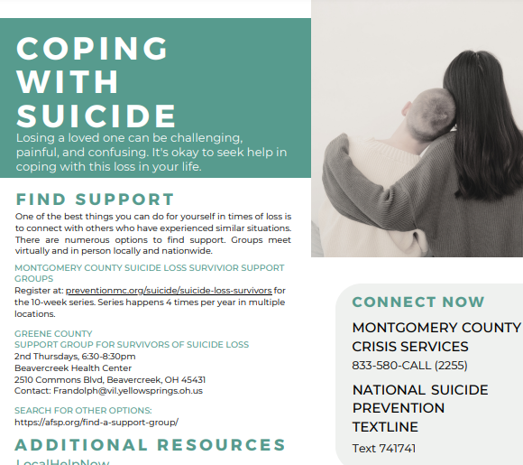
Member Participation
Challenge: Members disengage, stop attending, zone out, talk too much or too little.
Give context
Aggregate data or trends
Share successes
What happened with recommendations?
Solicit feedback
What can we do better?
NOVEMBER 12, 2024
COLUMBUS, OHIO
OHIO SUICIDE FATALITY REVIEW BEST PRACTICES SUMMIT

Slide 22
Suicide Prevention Coalition Engagement
Challenge: Incorporating work of SFR into local coalitions that may have existing action plans.
Share data, findings, trends
Participate in meetings, workgroups
Identify opportunities for collaboration
Montgomery County
LOSS Team
NOVEMBER 12, 2024
COLUMBUS, OHIO
OHIO SUICIDE FATALITY REVIEW BEST PRACTICES SUMMIT

Slide 23
Next of Kin Interview Recruitment
Challenge: Asking suicide loss survivors to share deeply personal stories without doing additional harm.
What can you offer?
A Listening Ear
Postvention Resources
Avoid Retraumatization
Recruitment Strategies
Letters, calls
Support Groups
NOVEMBER 12, 2024
COLUMBUS, OHIO
OHIO SUICIDE FATALITY REVIEW BEST PRACTICES SUMMIT

Slide 24
NOVEMBER 12, 2024
COLUMBUS, OHIO
OHIO SUICIDE FATALITY REVIEW BEST PRACTICES SUMMIT

Slide 25
NOVEMBER 12, 2024
COLUMBUS, OHIO
Thank You
OHIO SUICIDE FATALITY REVIEW BEST PRACTICES SUMMIT
For Your Attention

Slide 26
Contact Me
Susan Herzfeld, Epidemiologist
937-224-3770
sherzfeld@phdmc.org

