Slide 1
How to Implement Kognito Within Your Schools & Communities
A Webinar for Schools and Other Organizations Serving K-12 Youth
May 12, 2017
These trainings are offered [in part] under grant number 1H79SM062894-01 from the Substance Abuse & Mental Health Services Administration (SAMHSA), U.S. Department of Health & Human Services (HHS). The views, policies, and opinions expressed are those of the authors and do not necessarily reflect those of SAMHSA or HHS.

Slide 2
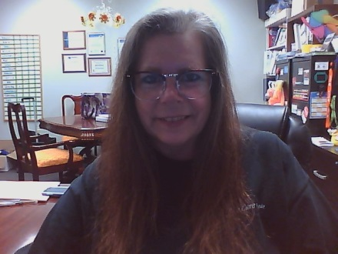
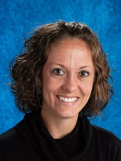
Today’s Presenters:
Jenna Hennek
Account Manager,
Kognito
Shawna Hite
SAMHSA GLS Grant Project Coordinator,
Ohio Suicide Prevention Foundation
Donna Dickman
Director,
Partnership for Violence Free Families
Amy Macechko
Health & Wellness Coordinator, Talawanda School District

Slide 3
Today’s Agenda:
Purpose of Today’s Webinar
Sharing from Guest Panelists
Q&A time with Donna & Amy
(please participate ☺)
Overview of Free Ohio Resources for Implementing Kognito Trainings
Ending Question for Panelists & Audience
(please participate ☺)

Slide 4
Purpose of Webinar:
Kognito Trainings are free to all Ohioans right now through SAMHSA GLS Grant SM062894
We want these trainings to equip school personnel across Ohio!
Ohioans are aware of free training opportunities…
Now is the time to take the next step!
Will provide you with success stories, tips, free resources, and the opportunity to discuss implementing Kognito
Use what you learn today in your schools & organizations ☺
OSPF & Kognito are here for support!
Notes:
This webinar is intended to be a stepping stone to you implementing these trainings within your schools & organizations. Our hope is that this webinar will provide you with valuable tips and resources as you begin to share these trainings. But we also hope that this webinar will serve as a reminder that OSPF and Kognito arehere as a support as you implement these trainings. Don’t feel shy: email Shawna and Jenna with questions!
Even if you don’t plan to implement the trainings now– That is okay. We would love to have you implement them this summer or next school semester! Let us know what your plans are so we can provide you with relevant materials, items, and support given where you are in the implementation process!

Slide 5
Donna Dickman
Donna Dickman, OCPS
Director, Partnership for Violence Free Families
419-549-8530 x1
ddickman@pvff.org

Slide 6
School Introduction:

Slide 7
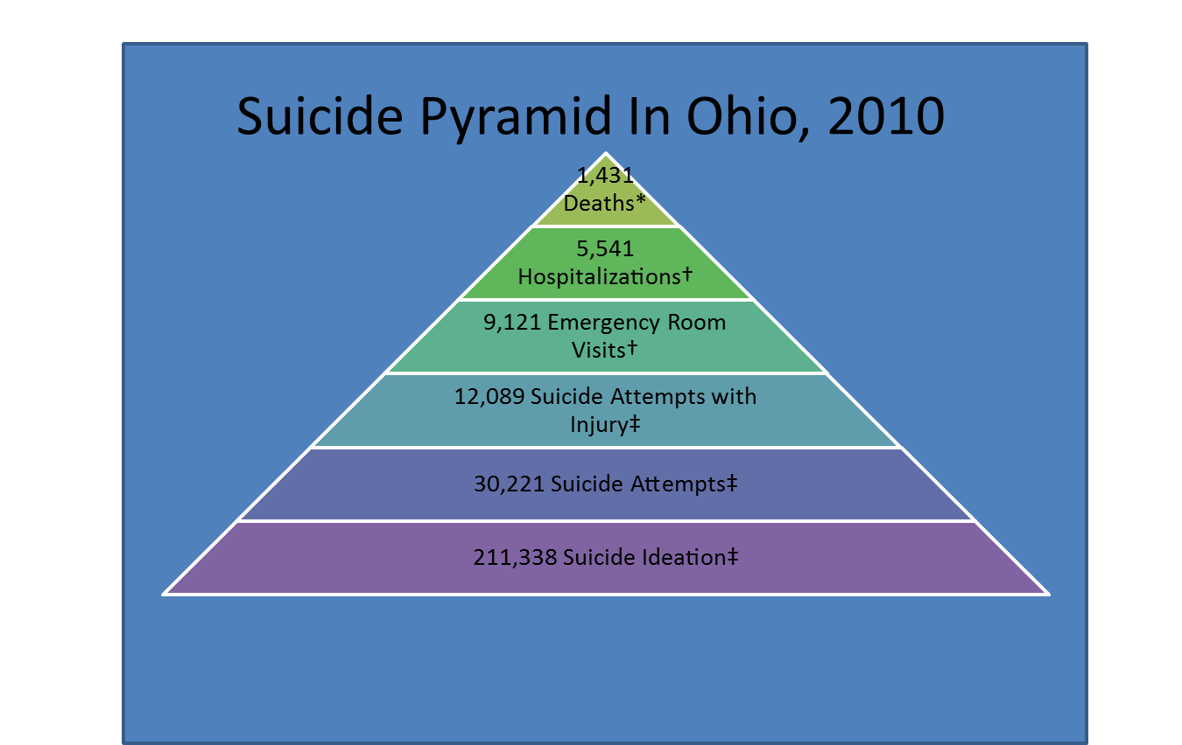
Shared State Statistics:

Slide 8
Shared Local Data:

Slide 9
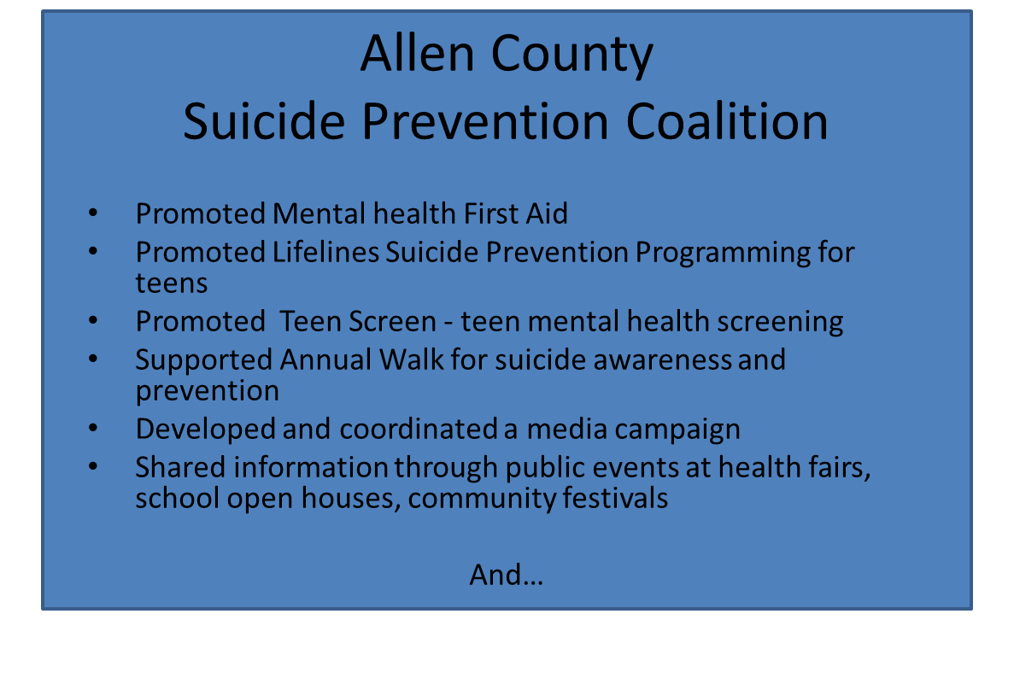
Shared Local Efforts:

Slide 10
Shared Kognito:

Slide 11
Amy Macechko
Health & Wellness Coordinator
Talawanda School District
macechkoa@talawanda.org
513.273.3390

Slide 12
Process:
Identified the need ⇛ Found a resource to match this need!
Shared with District Student Assistance Team:
Offered a demonstration
Got “buy-in” from the team
Offered it to staff as a voluntary opportunity:.
Low participation
Positive feedback from those who participated
Shared with the District Leadership Team:
Dedicate professional development time next school year for certified staff
Educational Assistants will participate at the beginning of the school year
Next Steps:
Looking to have 9th Grade Health students take the Friend2Friend
Simulation

Slide 13
Lessons Learned:
Dedicated time is critical!
Better facilitated if there is an identified need established.
Training model across disciplines - forward thinking!

Slide 14
Q & A:
Ask Panelists Your Questions on Promoting & Implementing Kognito Trainings:
Type your questions in the chat box.

Slide 15
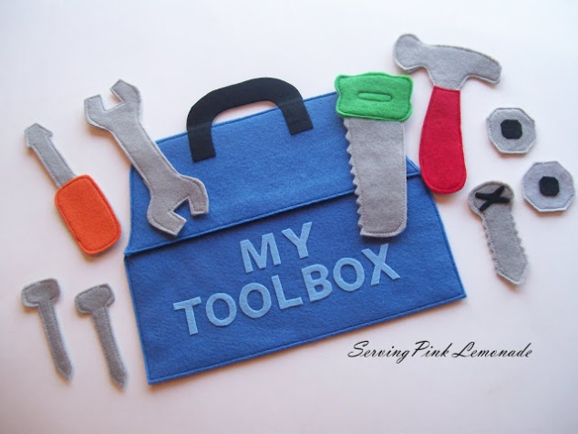
Resources for You!
OSPF wants to help you be successful in implementing Kognito!
Resources:
Kognito Resources Landing Page
Flyers
Past Power Points
Webinar Recordings
Kognito Champions Tool Kit
Kognito Champion Sign Up
Spread the Word Resources
Flyers
Power Point Slides
Pre-Written Messages
Discussion Guides
Notes:
As I said before, OSPF wants to be a valuable resource to you. One of the ways we are seeking to do this– in collaboration with Kognito– is to provide success stories and suggestions (as shown through our guest panelists). However, we also know individuals need materials, messages, etc. to be successful in implementing a new program as well. Because of this, we also have free flyers, power points, etc. etc. which you can download, print, copy & paste and use! We do not want you to have to create anything out of scratch!
You’ll see two main resources underlined on the power point. The first is a Resources Landing page on ohiospf.org which OSPF has put together in collaboration with Kognito. You can see a list of resources available on this page and I’ll go into more detail on how to find it in a minute.
But I also want you to be aware that there are even more resources available for you to download, copy, and use in promoting the trainings through Kognito. To do this, you simply visit their homepage for the adult trainings– and we’ll go into more details on this shortly as well.

Slide 16
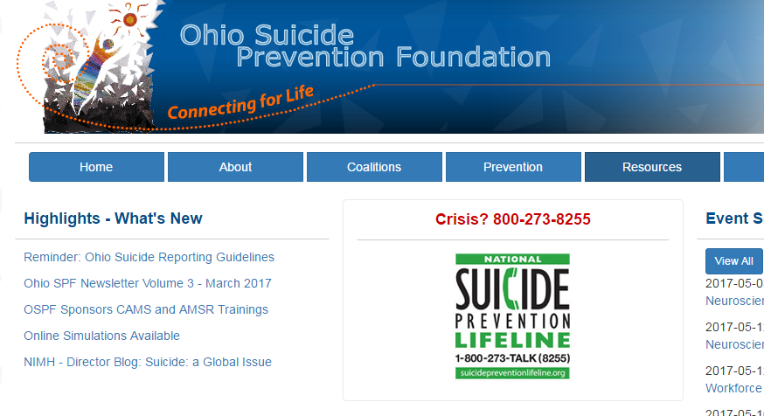
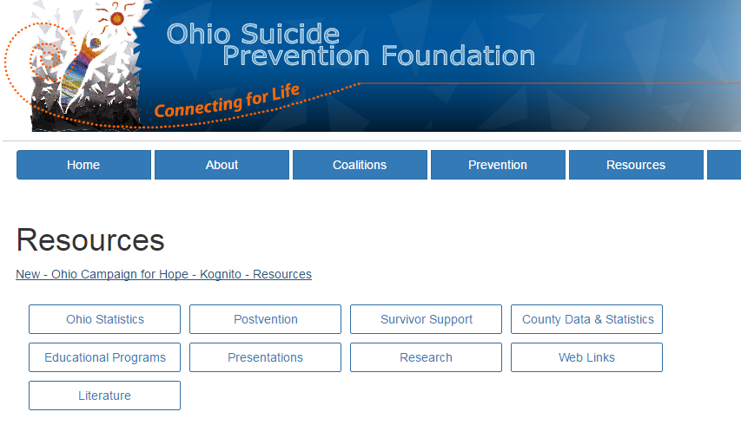
Resources for You!
Where to Go to Find OSPF Resources:
Ohiospf.org | http://ohiospf.org/content.php?pageurl=ocfh
Home Page→ Resources → “New- Ohio Campaign for Hope- Kognito- Resources”
Notes:
First, I want to show you how to find the Kognito Resources Landing Page on Ohiospf.org. It is not in a difficult place to get to. But I want you to all have easy and quick access!
You can see the steps to accessing the resource page in the dark blue lettering and snap shots of what you need to click on to visit the Resources Landing Page.

Slide 17
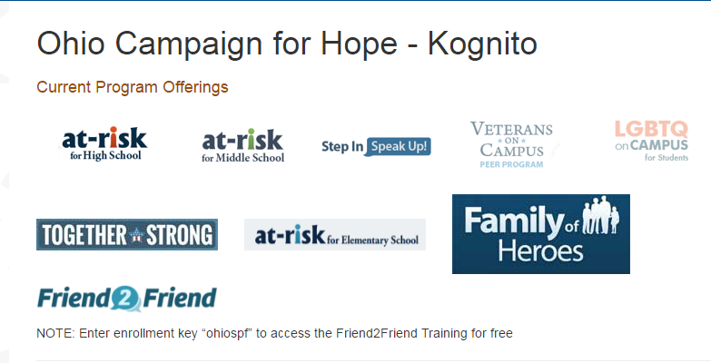
Resources for You!
Where to Go to Find OSPF Resources:
Ohiospf.org | http://ohiospf.org/content.php?pageurl=ocfh
Home Page→ Resources → “New- Ohio Campaign for Hope- Kognito- Resources”
Notes:
Once you are on the page, there will be several different sections of information available. What is shown on this slide is the top part of the Resources Landing Page. It provides you with access to all the trainings we currently have licenes to through Kognito. To access one training over another, you simply click on the appropriate image/title.
The At-Risk and Step-In, Speak Up Trainings are all accessed through the same ohio.kognito.com training. So they all take you to the same separate webpage. But you can choose which training you want to take once you arrive at ohio.kognito.com. This is a great page to give to you colleagues as well if they are interested in perusing different trainings.
Onle Friend2Friend, Family of Heroes, and Together Strong take you to separate webpages.

Slide 18
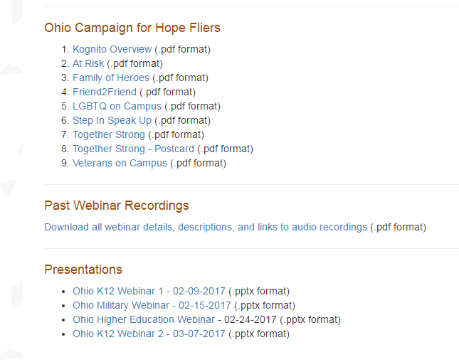
Resources for You!
Where to Go to Find OSPF Resources:
Ohiospf.org | http://ohiospf.org/content.php?pageurl=ocfh
Home Page→ Resources → “New- Ohio Campaign for Hope- Kognito- Resources”
Notes:
Beyond providing easy access to each training, this Resources Landing Page also provides a series of fliers which you can print off and use or just download and email around.
We will also be adding additional fliers to this webpage in the coming weeks.
Many of you were probably on our past webinars, and you can find recordings of all of those webinars on this page as well. Our webinar for K-12 feature a discussion on suicide in Ohio and information on what the training simulations are. Both webinars had guest speakers: 1) Delfin Bautista discussed LGBTQ youth on one, 2) a guest panelist from Ironton City Schools discussed the impact of the Kognito trainings on her district in the other. You can re-listen to these webinars to jot down key information. Or you can share them with other staff to help introduce them to the topic of suicide in youth and Kognito trainings.
Finally, you can simply access the power point slides from those webinars and forego the audio under the Presentations section on the Resources Landing Page. Feel free to download these power points and add in your own slides if you want to use them as a starting point for a presentation of your own. Or feel free to just pass along these slides.
In addition, today’s webinar and slides will be added to the Resources Page as well.

Slide 19
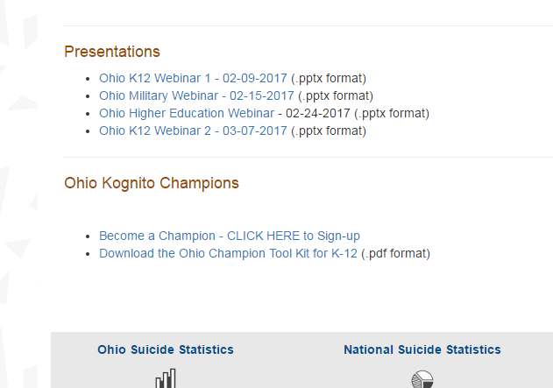
Resources for You!
Where to Go to Find OSPF Resources:
Ohiospf.org | http://ohiospf.org/content.php?pageurl=ocfh
Home Page→ Resources → “New- Ohio Campaign for Hope- Kognito- Resources”
Notes:
Finally, at the very bottom of the page is a section called “Ohio Kognito Champions”. This is ideally for everyone on this call who is really wanting to implement these trainings in their schools. This section allows you to sign up as a Kognito Champion AND to download a Champion Toolkit which provides helpful suggestions, tips, and information for sharing these trainings with your schools and organizations.

Slide 20
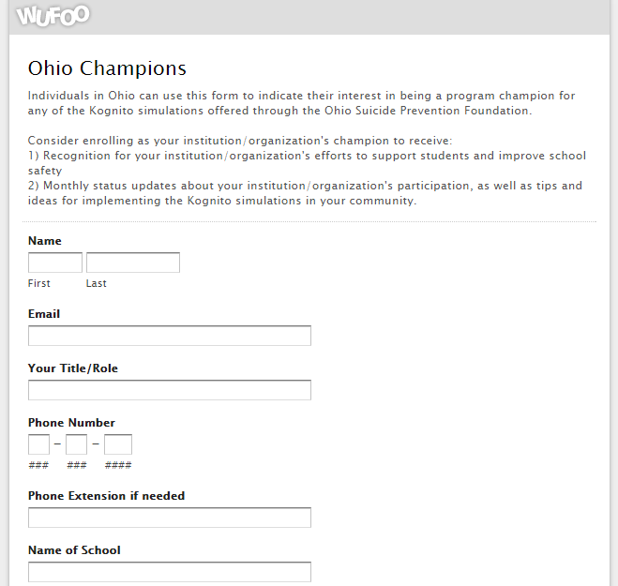
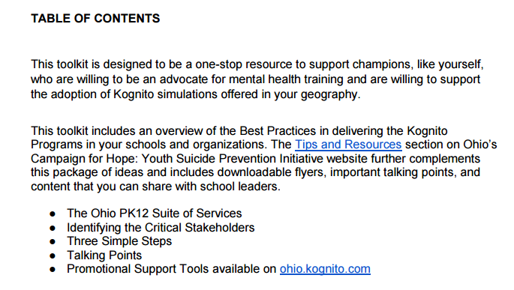
Resources for You!
Where to Go to Find OSPF Resources:
Ohiospf.org | http://ohiospf.org/content.php?pageurl=ocfh
Home Page→ Resources → “New- Ohio Campaign for Hope- Kognito- Resources”
Notes:
I have taken snapshots of what both those links will send you to.
On the left is the Ohio Champion Sign Up Link. It shows you some of the information you will provide. But by signing up and listing what school or organization you are from, you can begin receiving monthly reports on how many individuals are accessing the trainings and how many are completing. In addition, you will also receive monthly tips for implementing the trainings. If you are looking to keep track of usage for your own reports and to have ongoing support in implementing these trainings, signing up to become a champion is your best bet.
ON the right side of the screen, I’ve taken a snapshot of one part of the Champions ToolKi: The table of contents. You can see the different information provided: ranging from a discussion of what simulations are available for k-12 schools, to how to determine who your stakeholders are within your schools and organizations and who you need to contact to have support the trainings, to identifying the three key steps of promoting the trainings, to having talking points you can use in your discussions with others, and finally to links you can have for knowing where to find additional resources from Kognito.
Three Simple Steps: 1) Gain Support 2) Generate excitement & and usage 3) Incorporate best practices

Slide 21
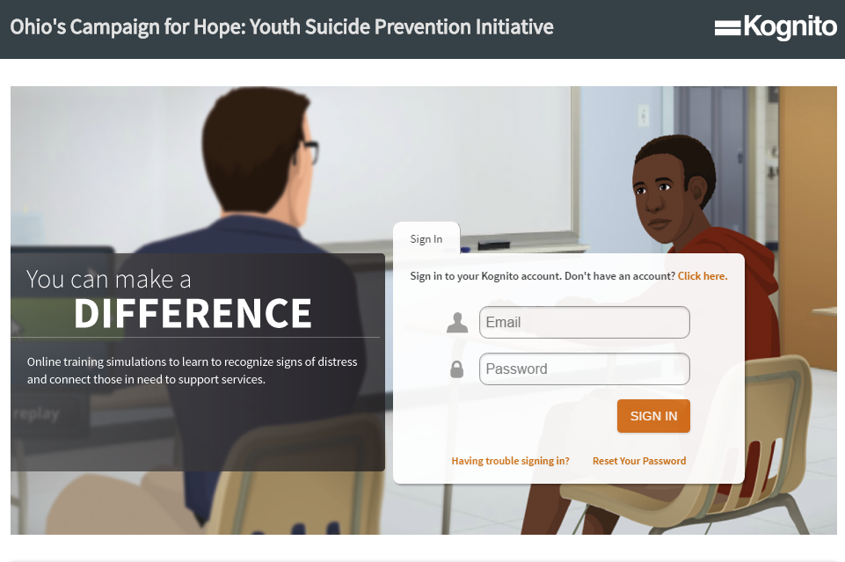
Resources for You!
Where to Go to Find Kognito Resources for Ohio:
ohio.kognito.com
Ohio’s Campaign for Hope Home Page→ Scroll to Bottom of Page → Under “Spread the Word” → Click on Tips & Resources for Schools → Click on “K-12”
Notes:
Kognito also has its own set of resources you can use. I will use the next several slides to discuss where to find these resources and how to use them. When you go to Ohio.kognito.com, you can register or sign in and access the simulations. You can also scroll down to the bottom of the screen and find more free resources to use in promoting Kognito trainings.
To find these resources you scroll way down to the bottom of the webpage.

Slide 22
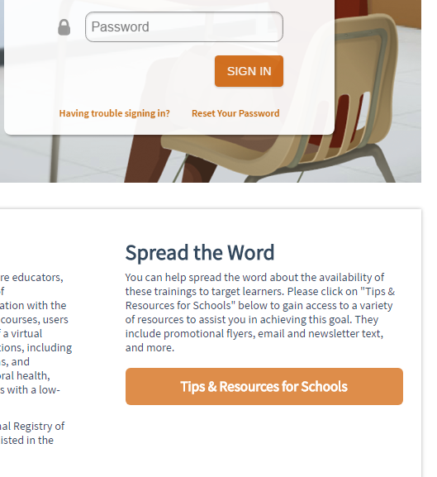
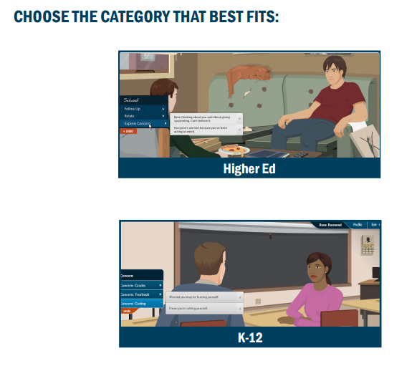
Resources for You!
Where to Go to Find Kognito Resources for Ohio:
ohio.kognito.com
Ohio’s Campaign for Hope Home Page→ Scroll to Bottom of Page → Under “Spread the Word” → Click on Tips & Resources for Schools → Click on “K-12”
Notes:
Once you get to the bottom of the webpage, you’ll see a section on the right hand side called: Spread the Word. Click on the Tips & Resources Box. Once there, you’ll click on the “K-12” box on a PDF. Again, all these steps are laid out in the dark blue lettering on this slide.

Slide 23
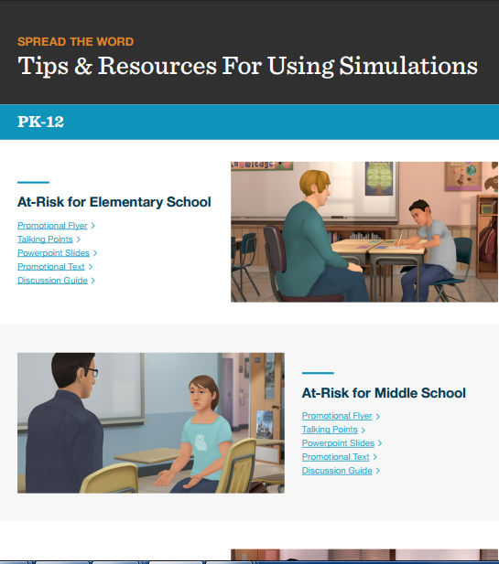
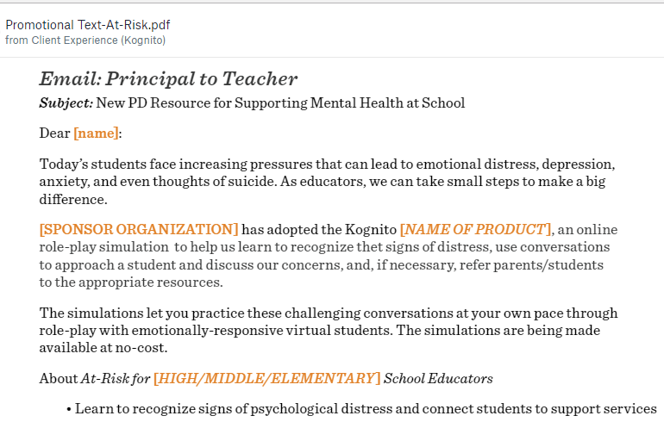
Resources for You!
Where to Go to Find Kognito Resources for Ohio:
ohio.kognito.com
Notes:
Once you click on K-12, you will be taken to another PDF with may active links. You can see on the right side of this screen what this PDF looks like: It is divided into resources for Elementary school, middle school, high school, Friend to Friend, and Step-In, Speak Up. Through this, you can find whatever materials are most relevant for you.
In the other two boxes, I have taken snap shots of two example resources available within each simulation area (aka within elementary, middle, and high school for example).
The box on the far left provides talking points and breaks these down into talking points for different subjects. For example, in the picture there are talking points for providing statistics on suicide in youth. But there are additional talking points on why it is important for everyone working with youth to take part in the trainings, and talking points on what users can learn from the trainings.
Lasty, the middle box demonstrates the promotional text which you can download, copy, and paste and send out to others. So in the box, it is an example email which a principle of a school could send out to teachers. But there is also example text for a newsletter or website.
I just highlighted a couple things available on this Tips & Resources sheet. But I would encourage you to check all of the resources out including the beautiful fliers, power points, and Discussion Guides.
In addition, as you begin exploring these resources (on bout OSPF and ohio.kognito.com), if there is something you could use to help promote the trainings, but is missing, please let us know! Email me and I will work to see that we get whatever resources are needed added to our site!

Slide 24
Question for Audience:
Ending Question for Panelists & Audience:
“What can OSPF provide to Ohio Schools which will aid you in promoting and implementing these trainings?”
Type your answers in the chat box.

Slide 25
Thank you!
Email Us/Call Us with Questions:
Shawna Hite, MPH, CHES
SAMSHA GLS Grant Project Coordinator
Ohio Suicide Prevention Foundation
2323 West 5th Ave. Suite 160
Columbus, OH 43204
shawna.hite@ohiospf.org
614-429-1528 ext. 402
Jenna Henek
Account Manager
135 W. 26th St |
12th Fl | NY, NY 10001
Tel: 212-675-9234 ext 121
Fax: 646.217.3677

